Slide 1
CUSATIAN’S
stage can be the CATALYST for a CHANGE
-- julee singh

Slide 2
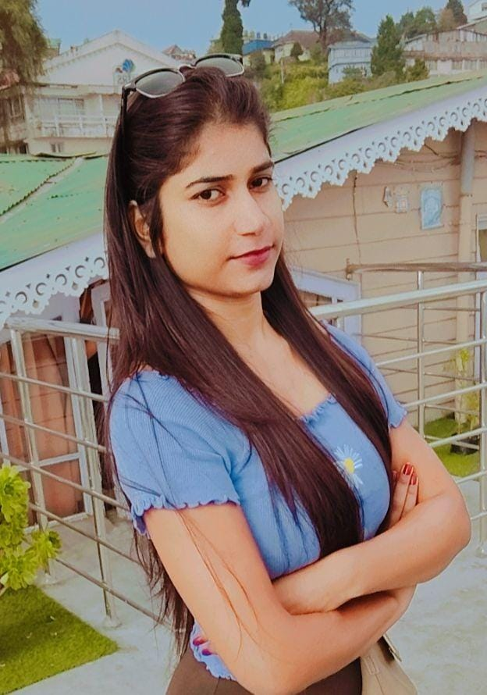
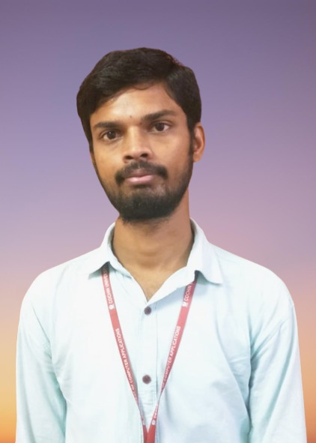
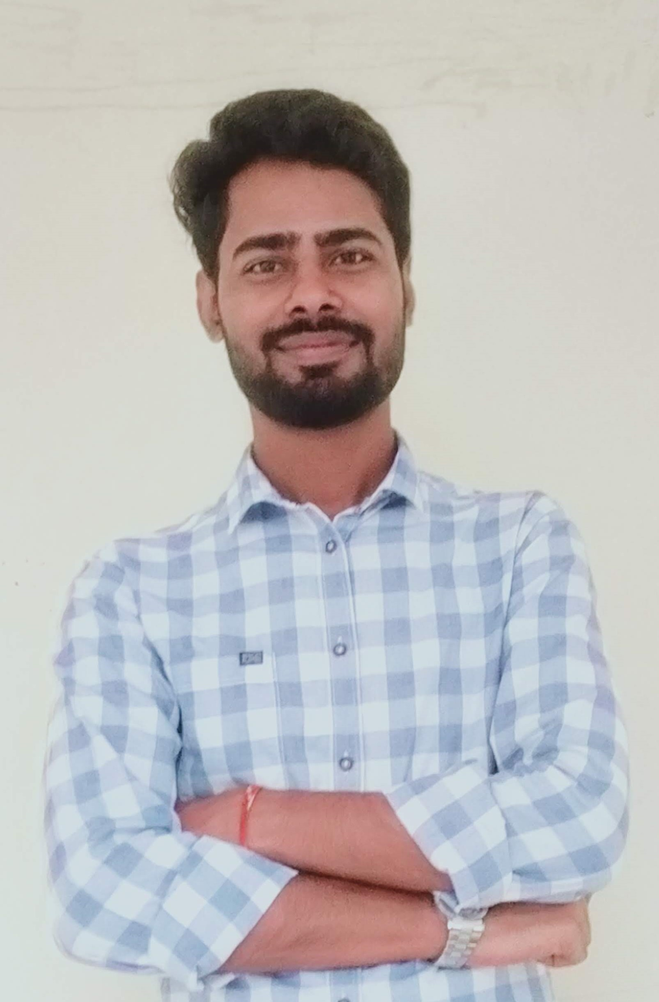
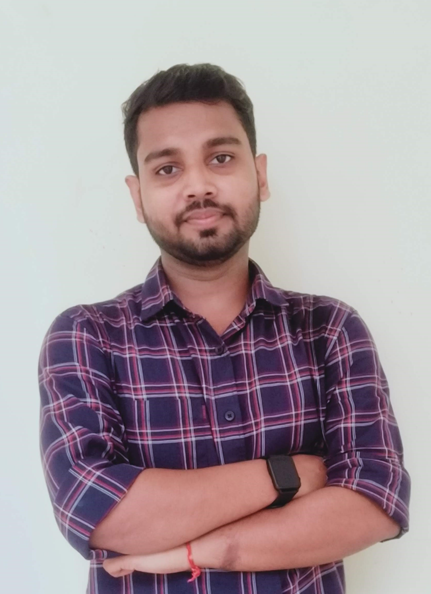
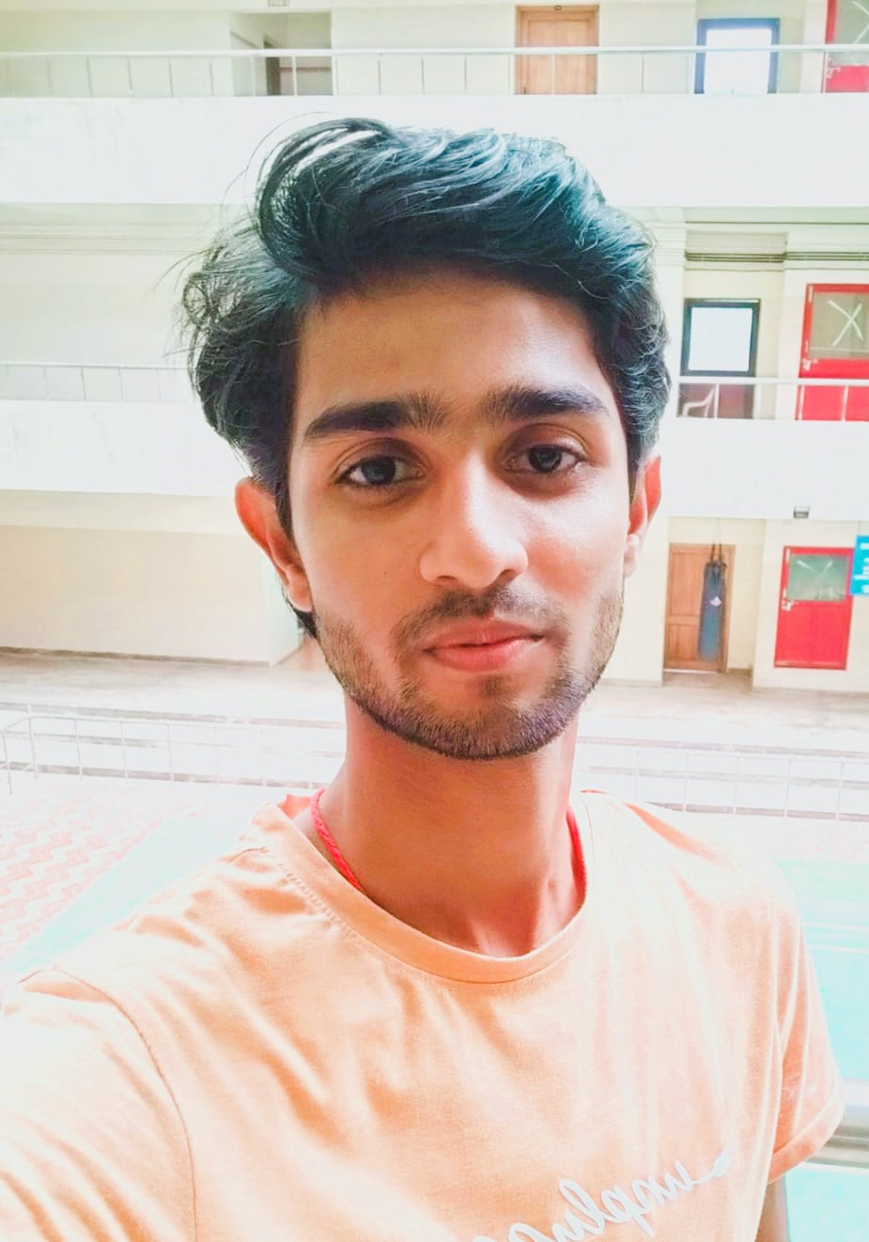
MEET OUR TEAM
Julee Singh
Roushan Kumar
Sumit Kumar Kamti
Om Shankar Babu
Saurav Sharma

Slide 3
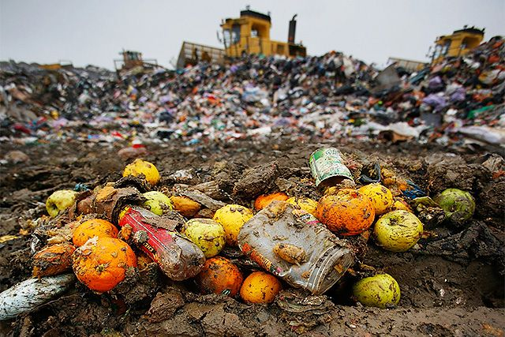
Food waste is the single largest material sent to landfills.
95% of wasted food goes to landfills
Notes:
Food scraps is single largest food component of landfill waste (95% of food waste goes to landfills)
There, contributes to methane emissions and leachate

Slide 4

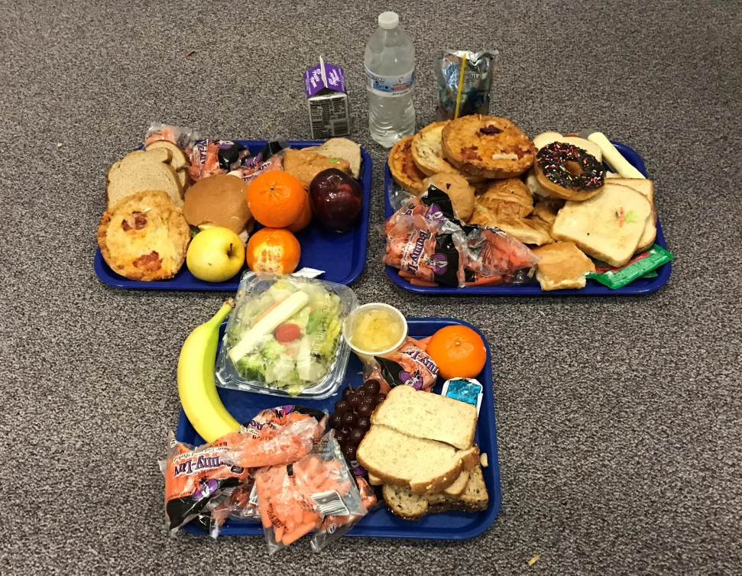
PROBLEMS
The sharp increase in huge amount of wastage of food makes the need for donation of food
Food wastage is not only a sign of
pollution or hunger, but also of many economic problems
Wasting food is major issue of food shortage, which leads to malnutrition. Wasting food is wasting money.
There are many people who wish to donate food to the needy but are unaware of how exactly they can execute that.
Notes:
When we do waste audits, we find food that kids don’t have teeth to chew, grape juice isn’t favorite juice, cauliflower in unopened packages. That food had to be thrown away due to language in contracts. Food service cannot require schools to throw out extra uneaten food. The food was the property of the food service company. Now that has changed.
Not too much detail – law says language cannot be included in the contract that uneaten food cannot be donated.

Slide 5
we have build an android app which connects common people and NGO’s that collect food to feed the poor.
Here’s the solution

Slide 6
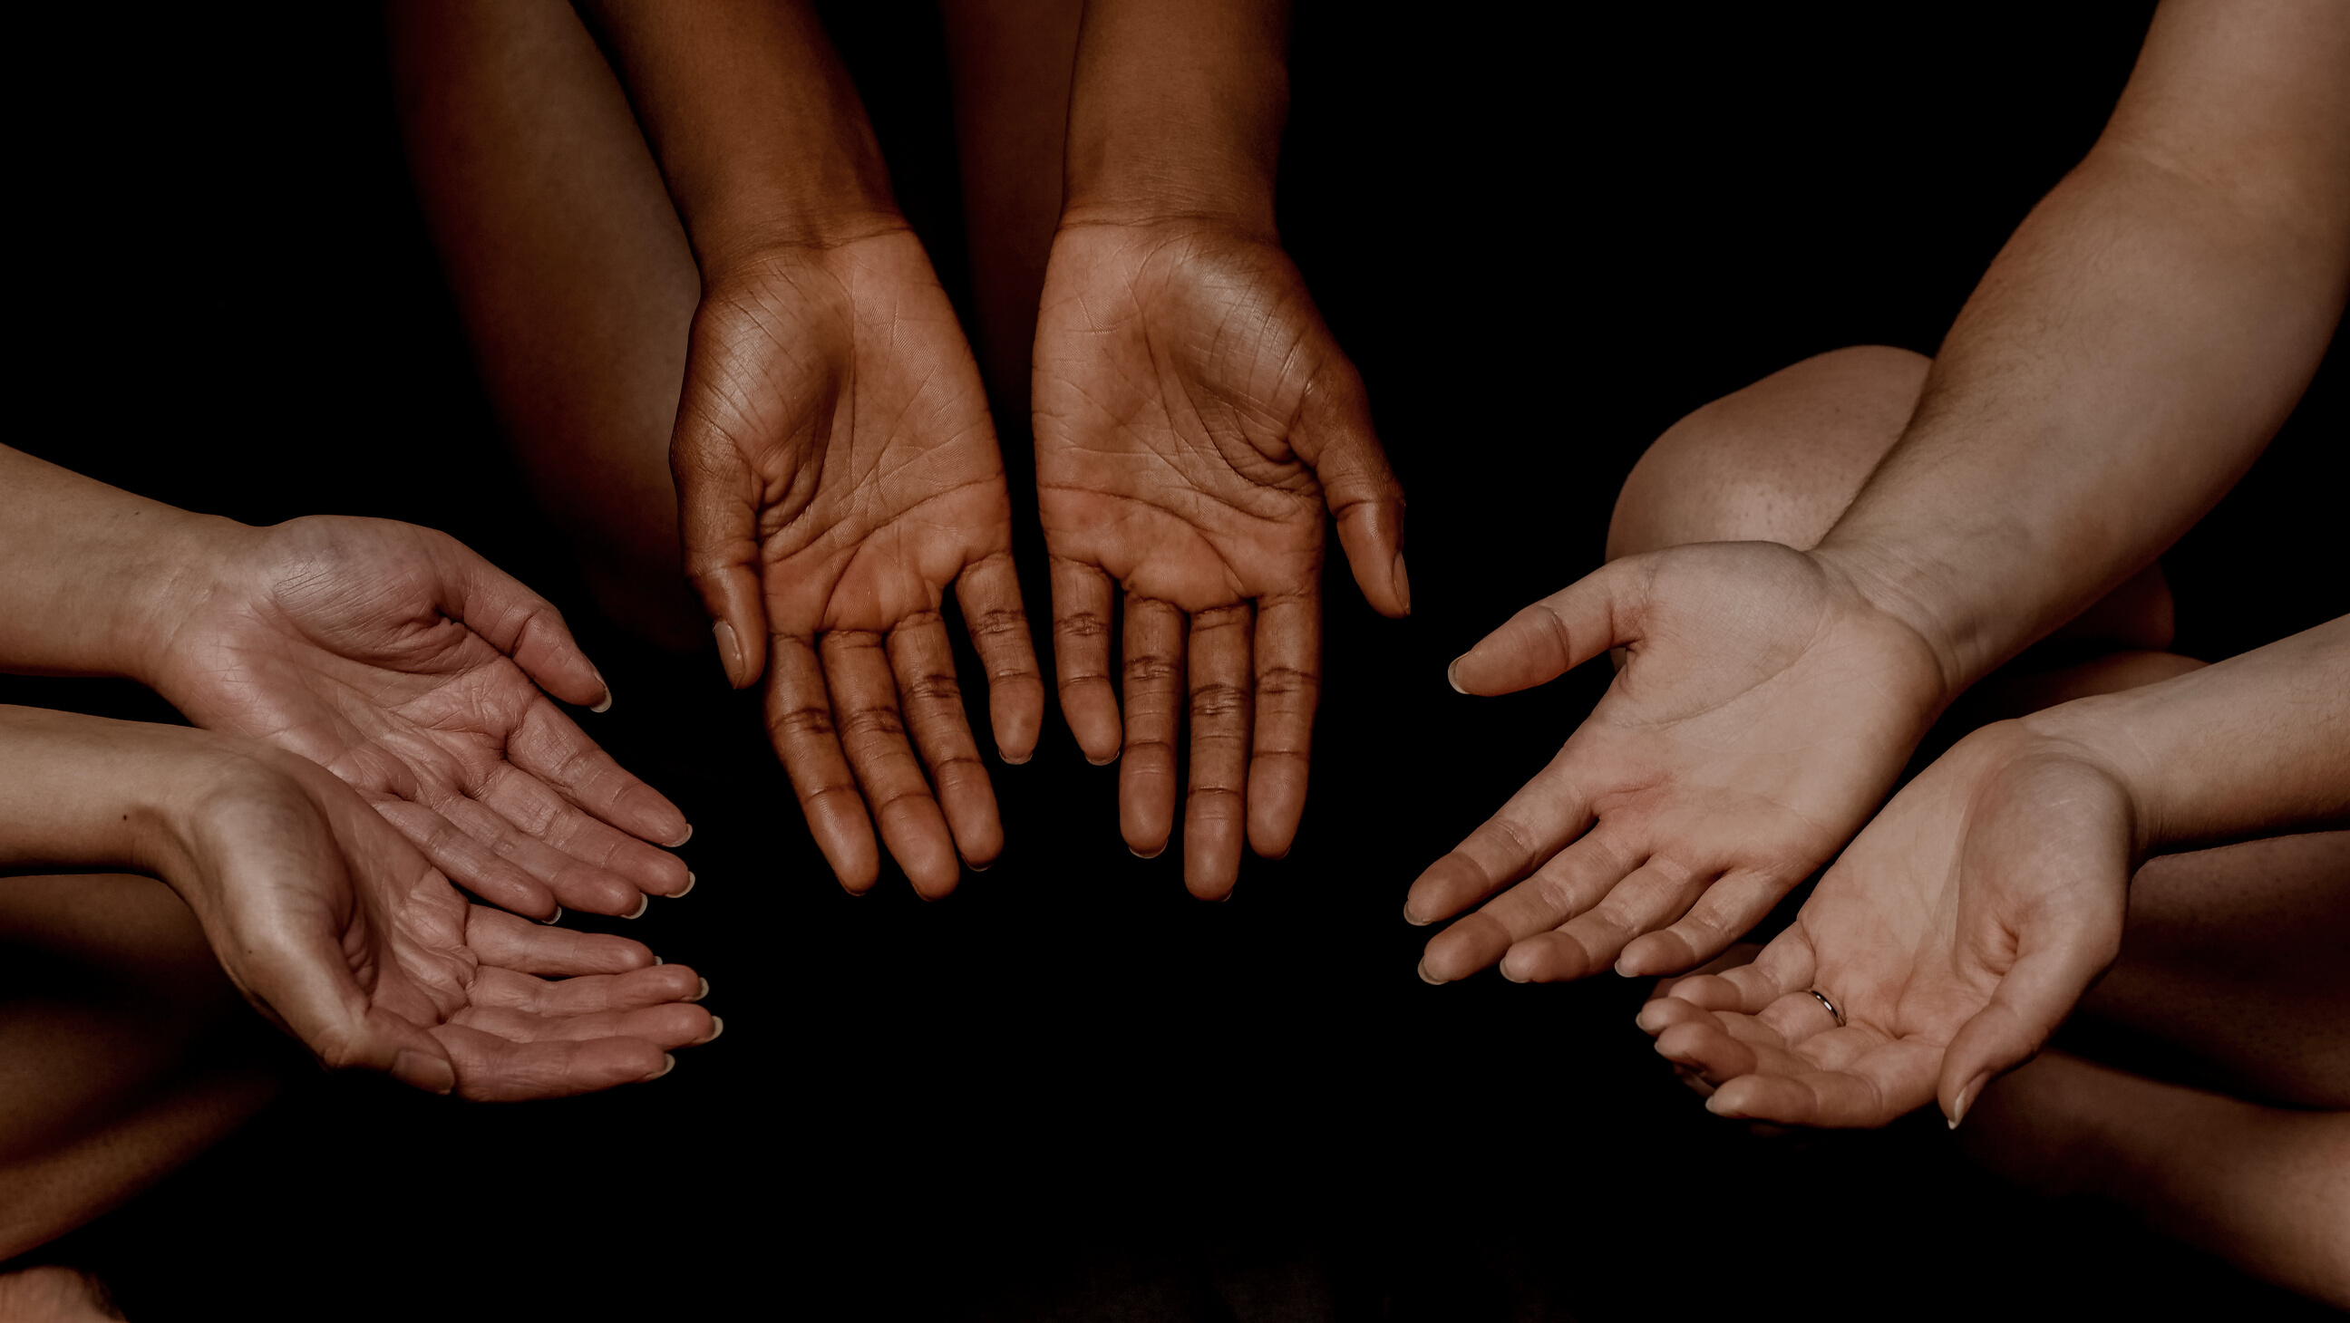
Food 2 Feed
Don’t Waste
Let’s Someone TASTE

Slide 7
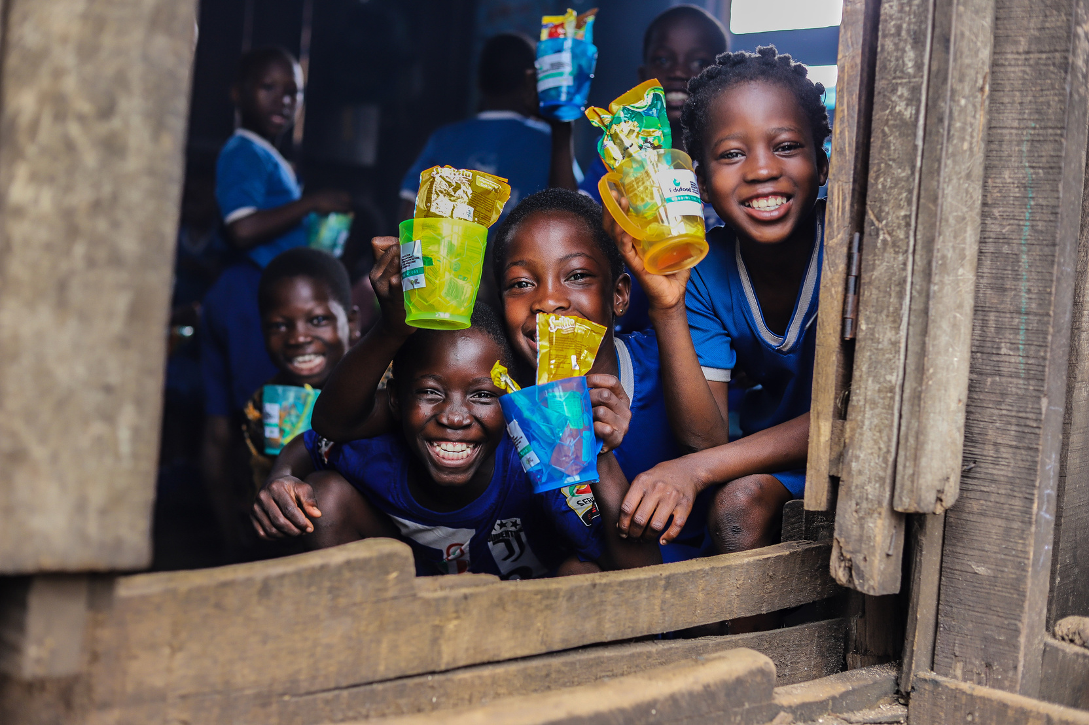
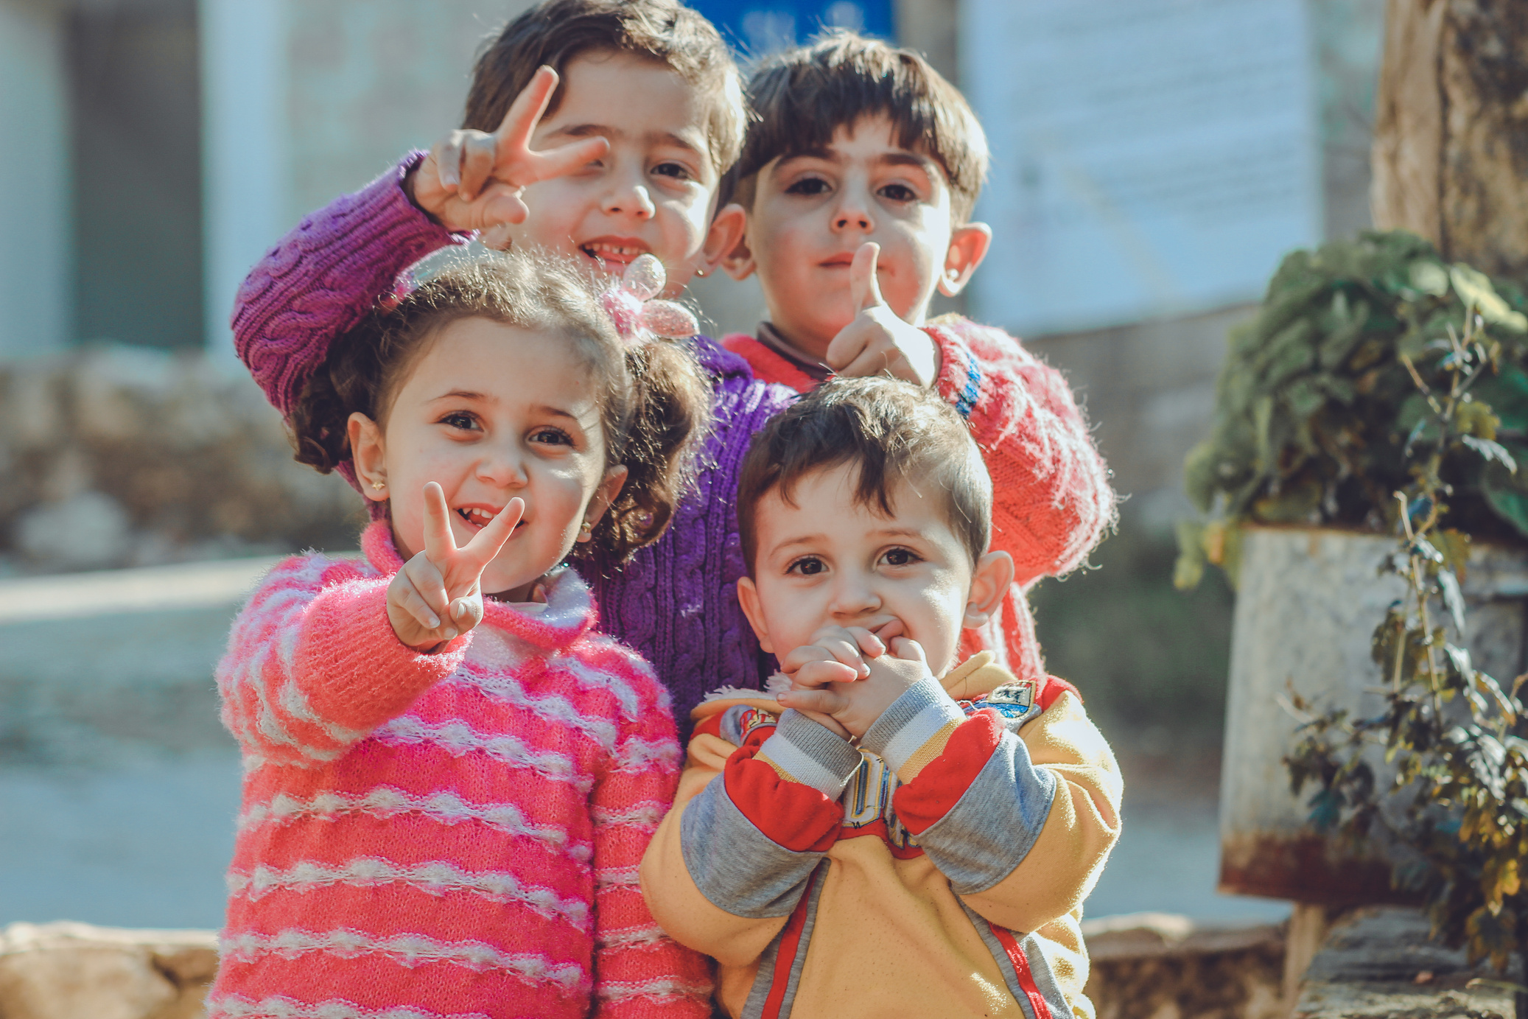
Introduction
This is a non profit application used to serve humanity.
Help To Give Hope.
leftover food donation is need of countering both FOOD WASTE and MALNUTRITION.
Help For Happiness.
Our application revolves around helping the needy by connecting NGO’s and Common people.

Slide 8
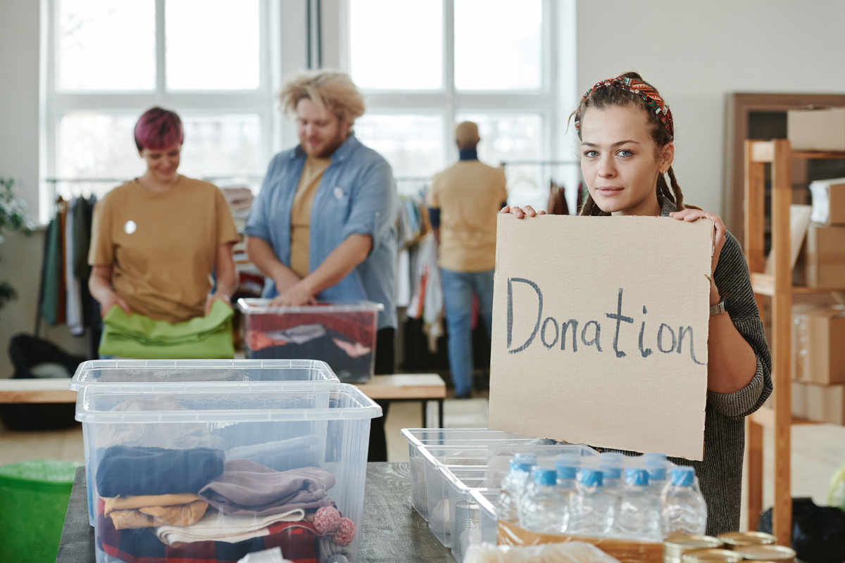



Vision & Mission
Share And Send Smiles.
+234 Place
Almost 20lakh street children in Mumbai go to sleep hungry everyday
Vision
.To build a future in which people values everything to conserve nature and promote social works among youth.
90% Donation
we can see that
many people throw foods in dustbin even the food eatable
condition.
Mission
We strive to provide a platform that connects NGO and common people to collect the food that is not consumed can be served to the needy people.

Slide 9
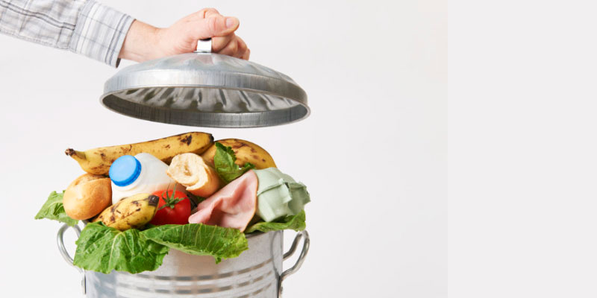
Objective
Donations help provide food to hungry people and also reduce food waste
30% of U.S. food supply is wasted at retail and consumer levels
Don’t just “clean out your cupboard” and donate foods you can no longer use
Donate safe and healthful food to help pantries avoid waste and keep customers healthy

Slide 10
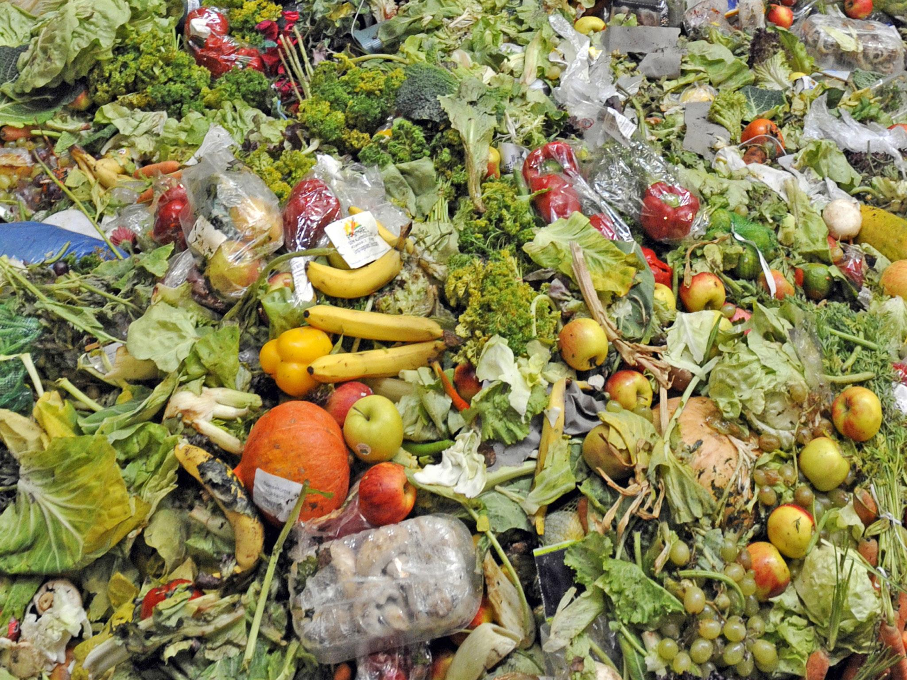
Food Waste
Food waste occurs along the entire spectrum of production, from the farm to distribution to retailers to the consumer. Reasons include losses from mold, pests, or inadequate climate control; losses from cooking; and intentional food waste.
Notes:
Source: https://www.usda.gov/oce/foodwaste/faqs.htm
More than 20lbs of food per person in USA per month
Save the Food has some per person #s
Food waste per capita has increased by approximately 50% since 1974 (source: http://journals.plos.org/plosone/article?id=10.1371/journal.pone.0007940)
Other Notes on Food Waste (broadly):
NRDC Report – Wasted: How America is Losing Up to 40% of It’s Food from Farm to Fork
EndFoodWaste.org – Petitions for stores to stock ugly produce (Currently Alberstons (Jewel), Target); run Ugly Fruit & Veg Campaign (follow on FB, Twitter, Instagram)
Tristram Stuart - FeedBack, TED talk
Rob Greenfield #DonateNotDump, The Food Waste Fiasco
Sustainable America - I Value Food
SavetheFood
US EPA – Food: Too Good to Waste guide for reducing household food waste, can be implemented on community-wide scale
NRDC – Save the Food
USDA/EPA – U.S. Food Waste Challenge
Film: Just Eat It (available to stream on Amazon and iTunes)
Food Waste: Last Week Tonight with Jamie Oliver
PBS Newshour: Why are tons of fresh produce dumped in landfills every day?
NRDC/Harvard Food Law & Policy Clinic: The Dating Game: How Confusing Food Date Labels Lead to Food Waste in America

Slide 11
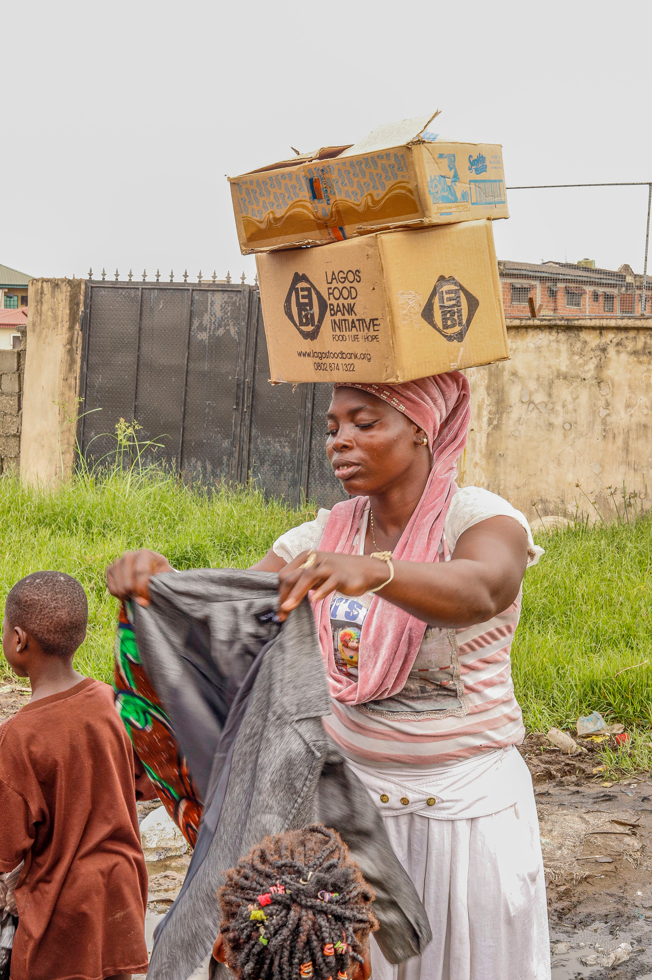
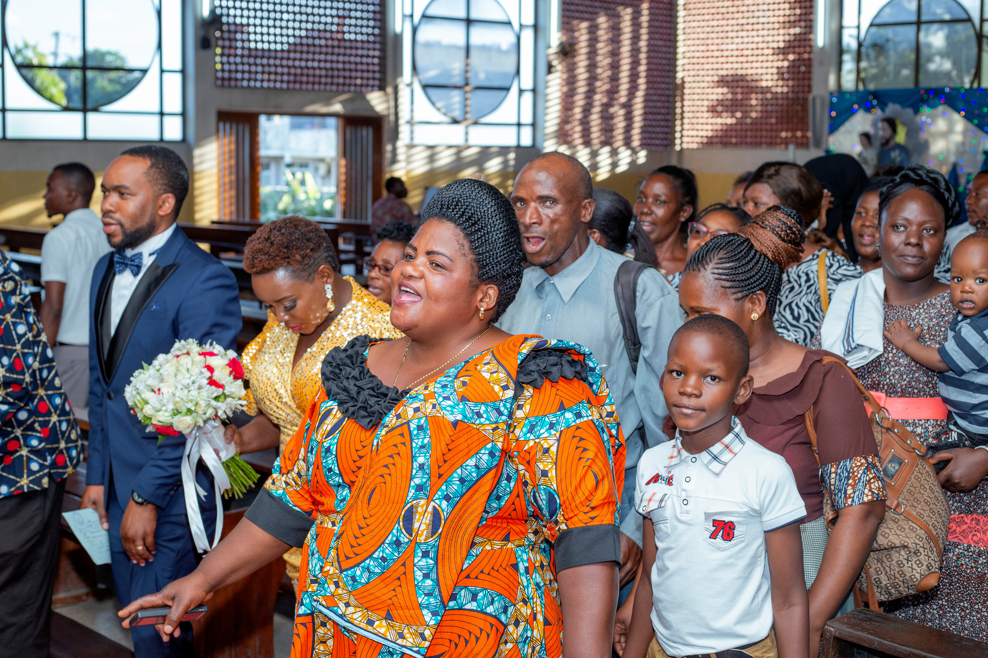
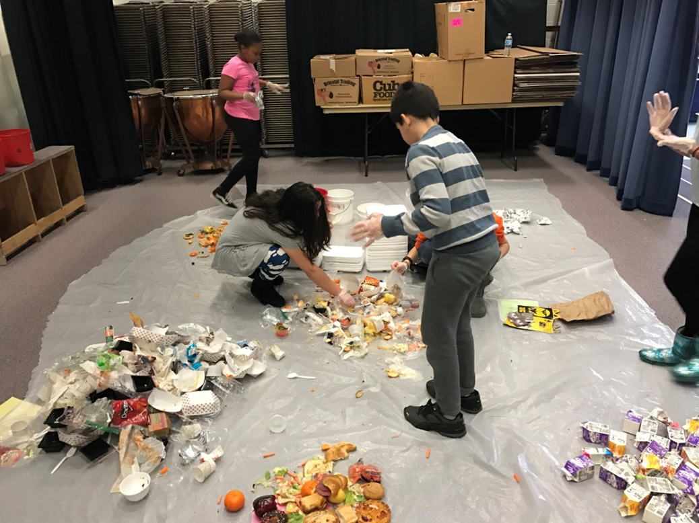
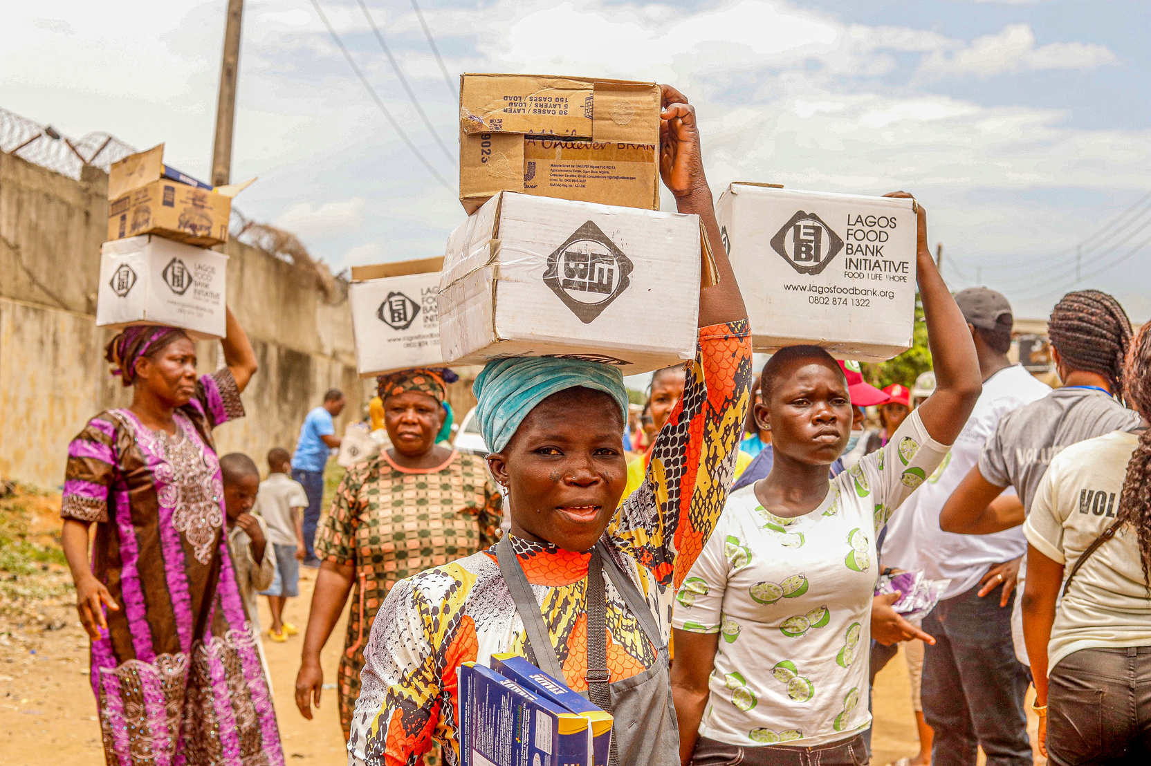
USERS:
Admin: organizations that collect food to feed the poor.
Donors: people who donate food to an organisations

Slide 12
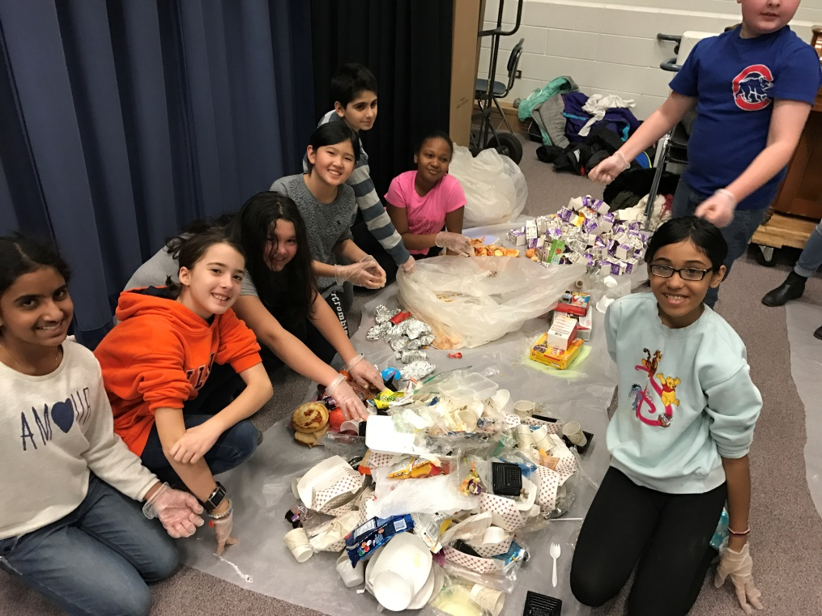
Donors
Anyone who wish to donate food.
Restaurants
Caterers at wedding venues
Party organizers
Hotels
Hostels
Common people
.
Notes:
Heritage lakes april 2016

Slide 13
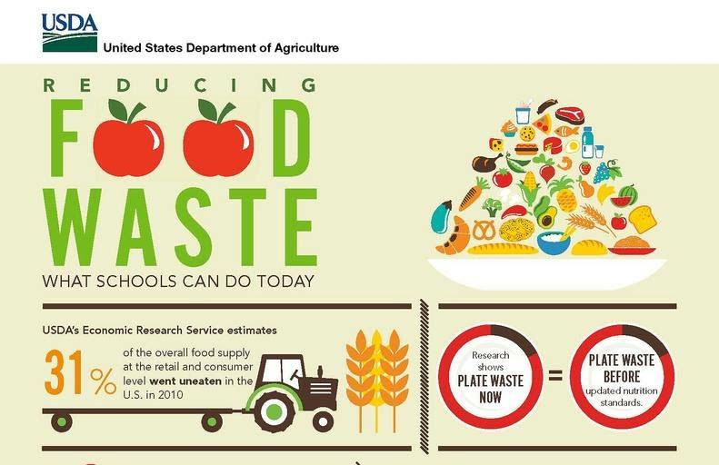

Slide 14
STEPS FOLLOWED TO DONATE FOOD
Evaluating the requests from donor
Confirmation by admin
Login or register
Step 3
Step 1
Step 2
Step 4
Step 5
Step 6
details of food is to be mentioned
check the requirement and location
Delivered to organization

Slide 15
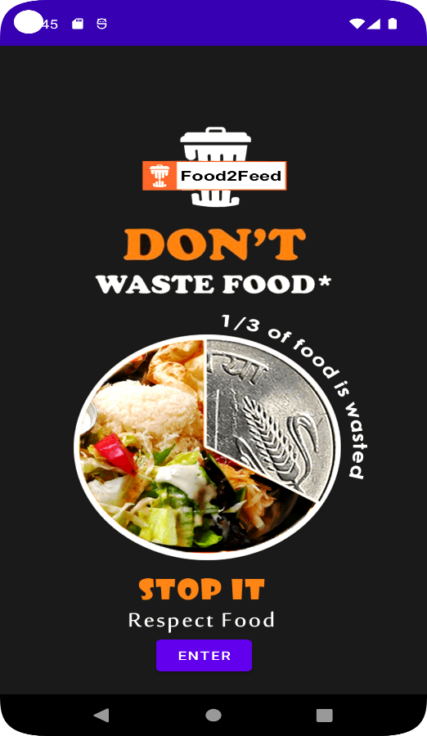
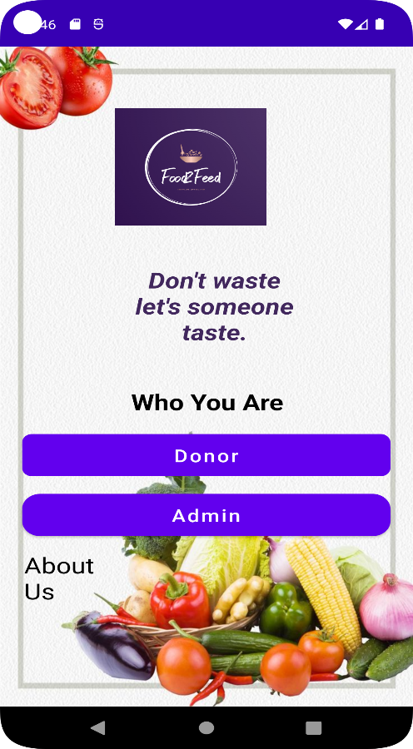
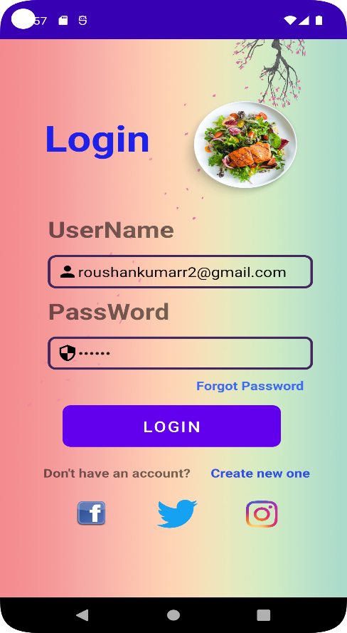
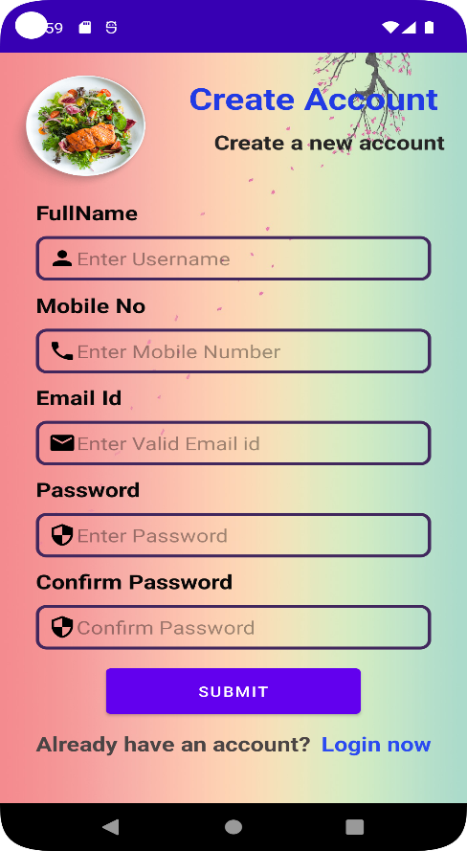
INTERFACE

Slide 16
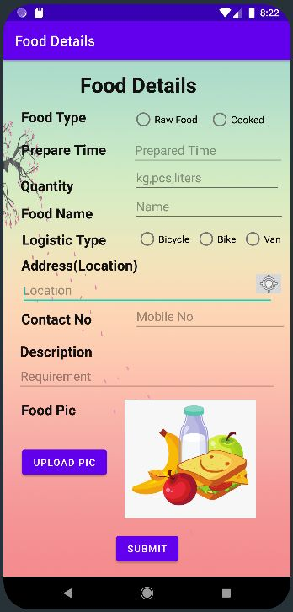
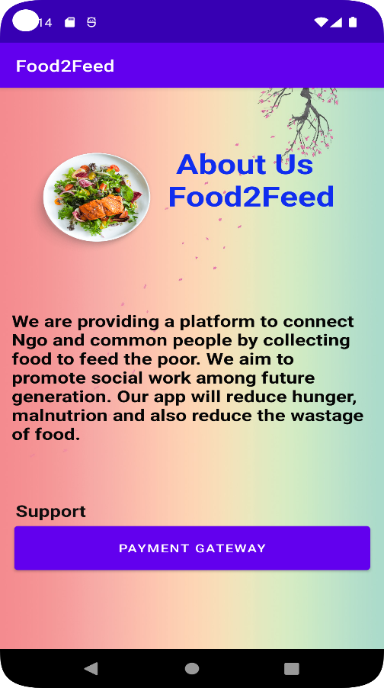
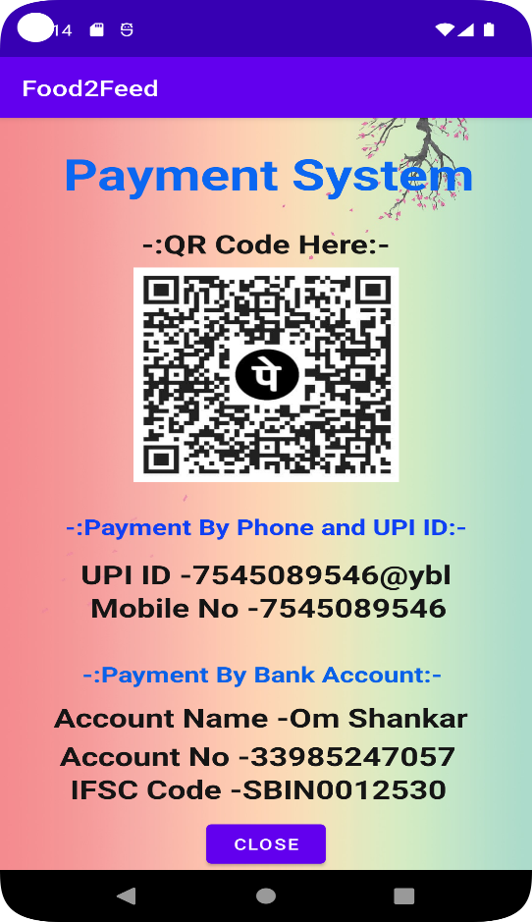
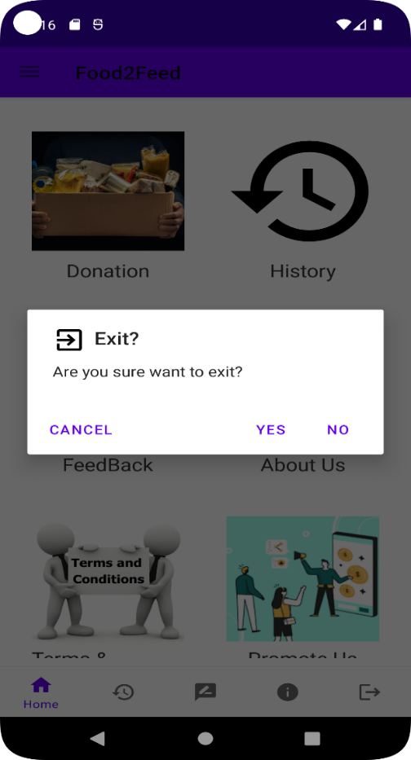

Slide 17
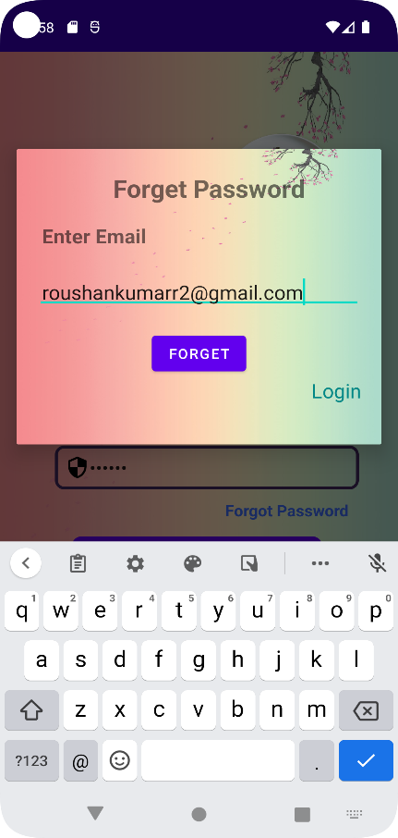
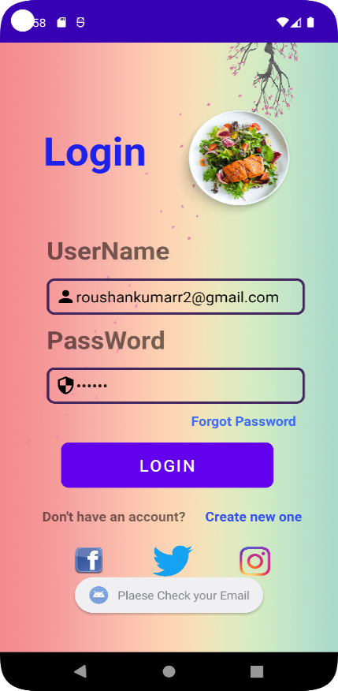
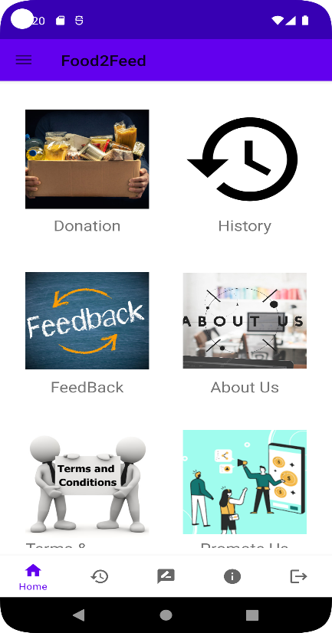
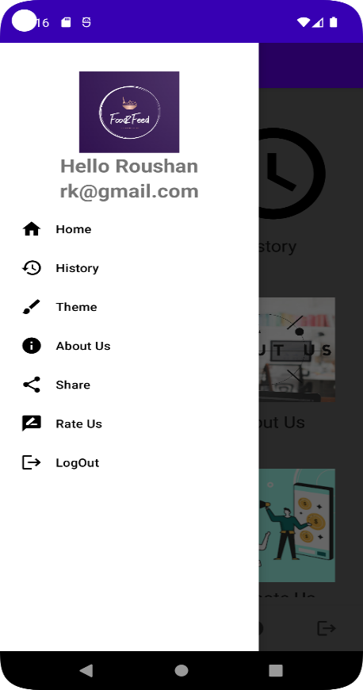

Slide 18
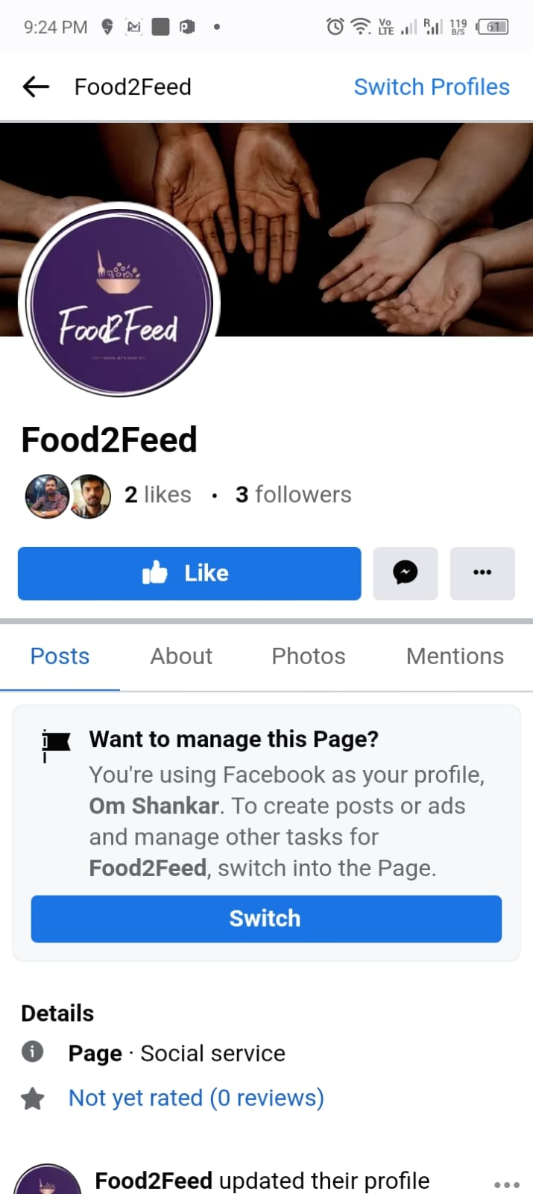
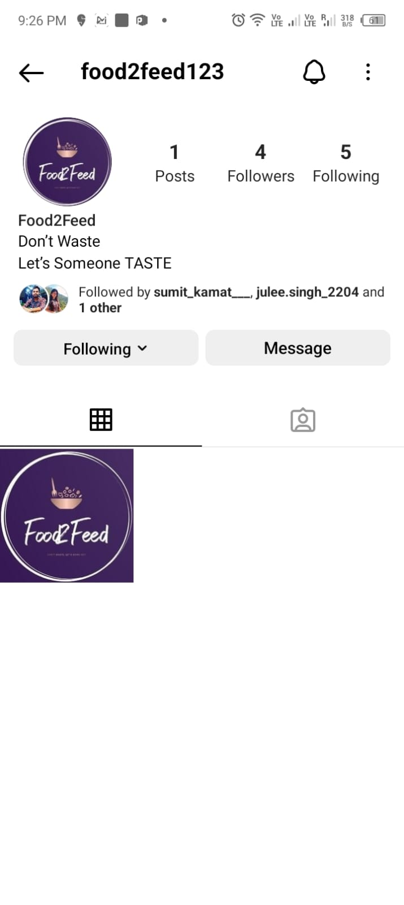

Slide 19

Can I donate……?
NO!
Expired food (pantries can ~distribute though)
Spoiled, moldy food
Home canned or prepared foods
Opened or repackaged food
~Damaged packages, dented cans

Slide 20

Can I donate……?
It depends-
Fresh fruits and vegetables
Refrigeration-required foods
Frozen foods- no large ice crystals
Meat and poultry must be from licensed processor
*read the terms and conditions mentioned in our app to find out what we can accept

Slide 21

Can I donate……?
YES!
Non-perishable, nutritious canned and packaged foods
Monetary donations
Volunteer time

Slide 22
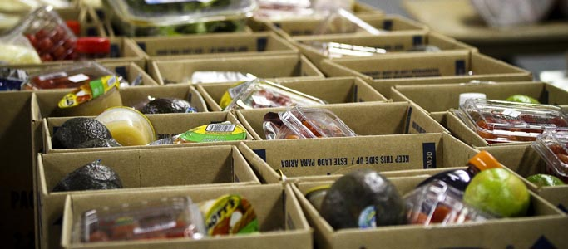

Terms and conditions
User needs to fill the personal details like id proof beforing donating
User needs to fill all the description about the quality and quantity of the food.
It totally depends upon the admin whether to accept or reject the donation order.
Availability and requirement should be mentioned
Once the order is accepted then donor can’t cancel it.
User Should read all the terms and condition given in the app before donating.
© 2017 SCARCE Inc
Notes:
Still in commmittee as of 09/13/17

Slide 23
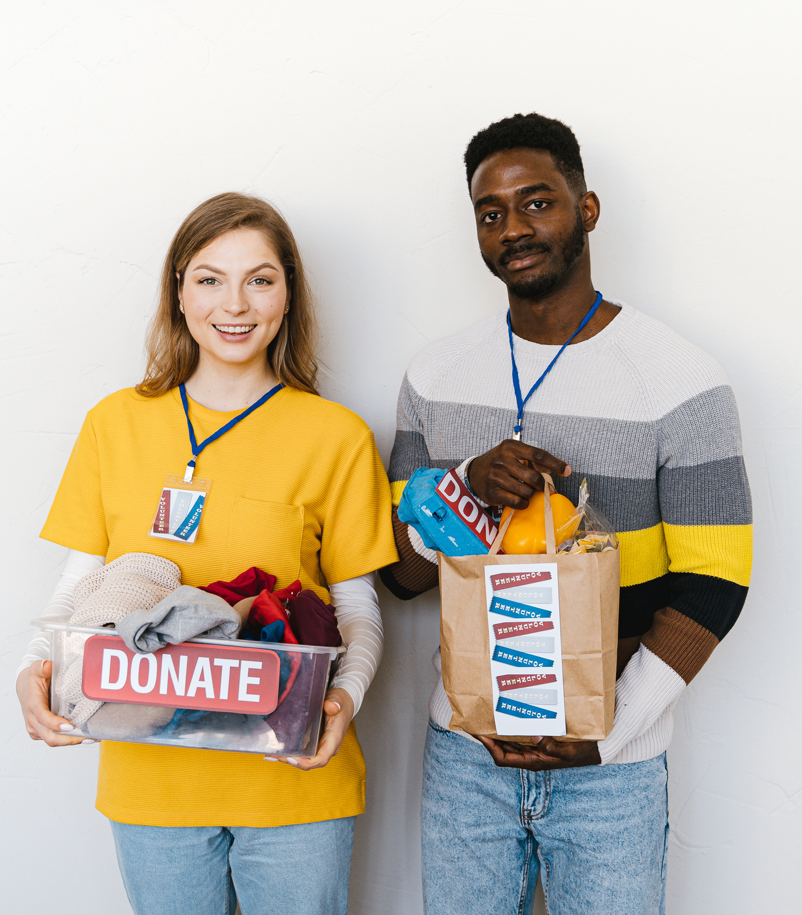
Future Scope
Let's start sharing happiness and inspire people.
This is an initiative to provide platform to reduce hunger and malnutrition but in future it can be extended to donate more items that could serve the needy.
Items to donate :
Books that can increase the literacy rate
clothes and uniforms to wear
medicines
toys or any used gadgets
second hand products to be used by many people.

Slide 24
>>involving more number of people to donate is our main motive so it would be mandatory to give the review of the app. >> Positive review will attract more people to use our app. >> Negative review will be taken as a feedback to work on.

Slide 25




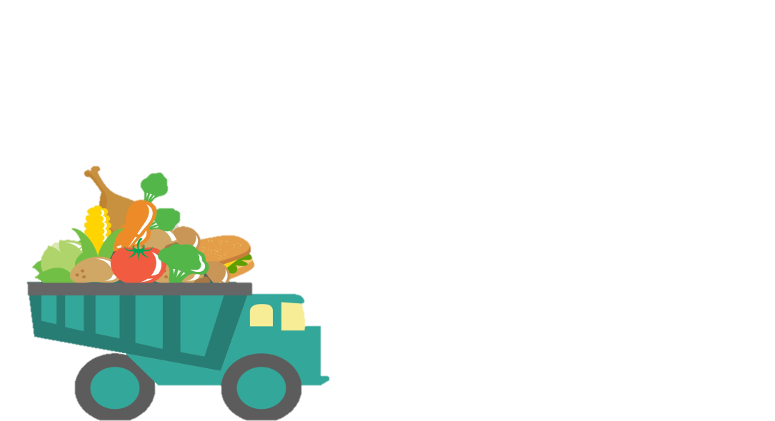
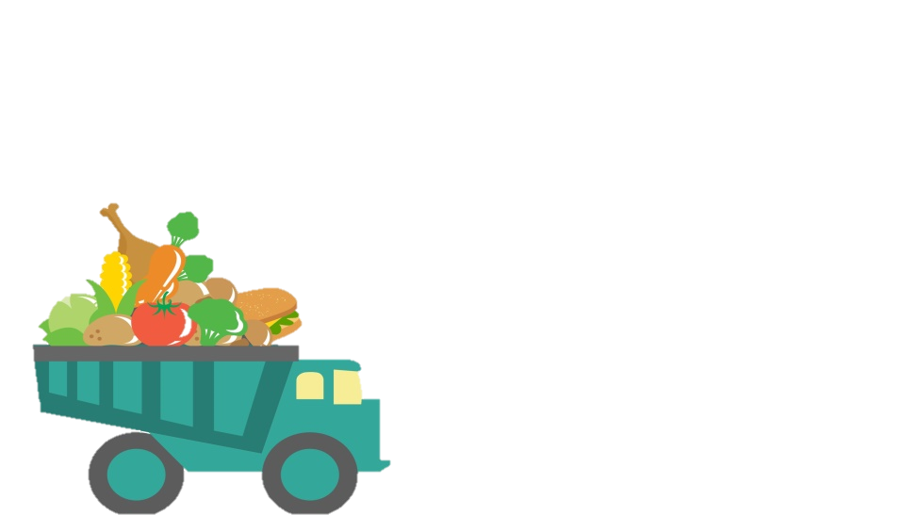
CONCLUSION

Slide 26
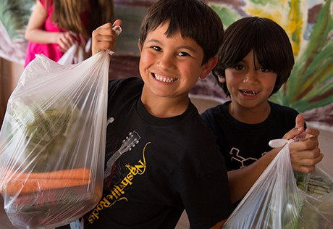
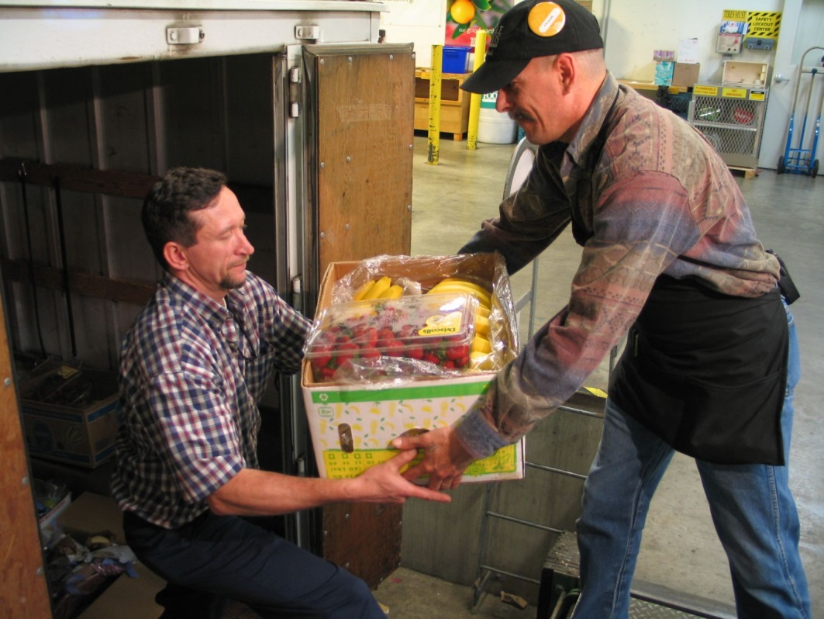
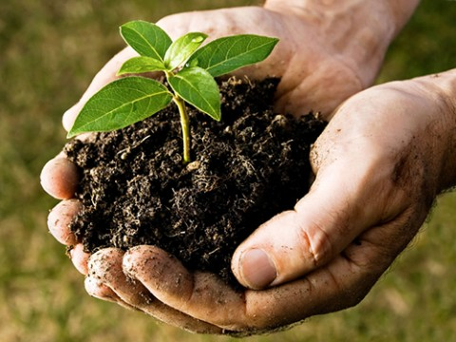

Feed People
Not Landfills
Feed soils
© 2017 SCARCE Inc

Slide 27

THANK YOU
YOUR HEART, YOUR CENT, THEIR HOPE, THEIR FUTURE.
JOIN US AT REALLYGREATSITE.COM

